Slide 1

1
ADVOCATING HEALTHY EATING THROUGH SMARTPHONE APPLICATION
MYNUTRIAPPS II: MYNUTRIDIARI
Zalma AR, Teh WS, Leong HY, Munirah MN Nutrition Division
Ministry of Health Malaysia
8th National Public Health Conference, 2-4 August 2016

Slide 2







Introduction
2
35%
30%
25%
20%
15%
10%
5%
0%
29.10%
29.40%
30.00%
16.60%
17.70%
14.00%
15.10%
4.40%
1996
2006
2011 2015
Overweight
Obesity
Berlebihan Berat Badan
Obesiti
Reference: National Health and Morbidity Surveys, NIH

Slide 3
Introduction
3
According to the National Health and Morbidity Survey, the prevalence of obesity had increased from 4.4% (1996) to 14.0 % (2006), 15.1% (2011) and 17.7% (2015).
One of the main contributing factors to obesity is unhealthy eating habit.
Various strategies are needed to combat obesity.
Latest medium of communication - smartphone application.
“MyNutriDiari” was developed as an interactive tool to inculcate healthy eating habits and disseminating nutrition information to the public.

Slide 4

Objective
4
Objective:
To increase knowledge on calories and the importance of monitoring calorie intake amongst the population.
To create a calorie conscious community, as a strategy to combat obesity.

Slide 5
Uniqueness of MyNutriDiari
5
Locally developed interactive smartphone application which helps users to monitor calorie intake and physical activities.
Based on local foods – 5000 foods (2200 cooked foods & 2800 food products).

Slide 6

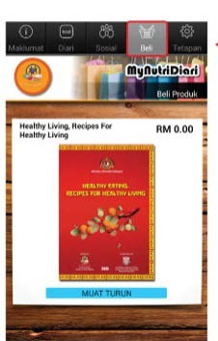
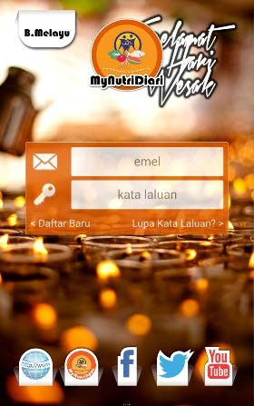

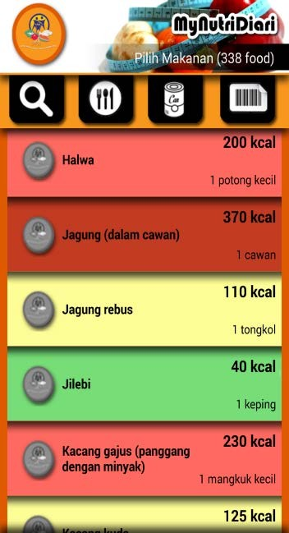


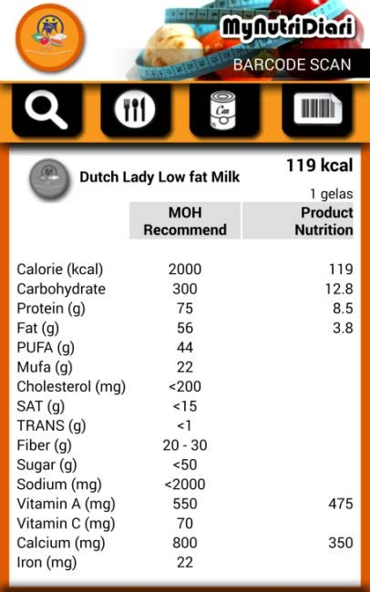
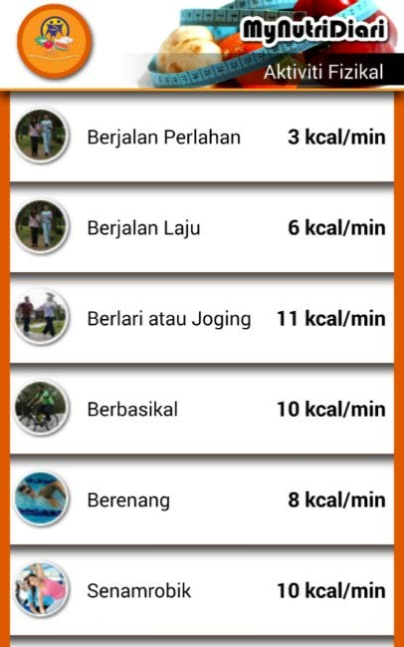
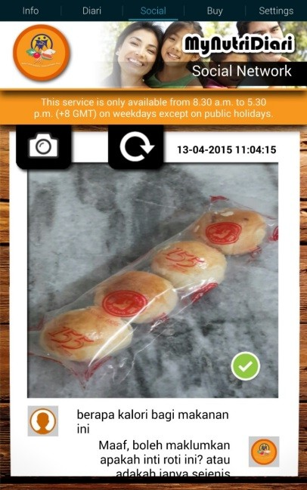



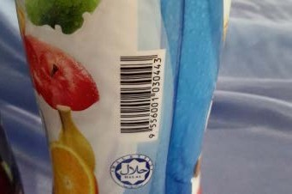
MyNutriDiari Modules
6
[ ]

Slide 7
FOOD DIARY
7

Slide 8

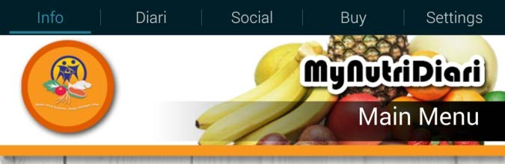
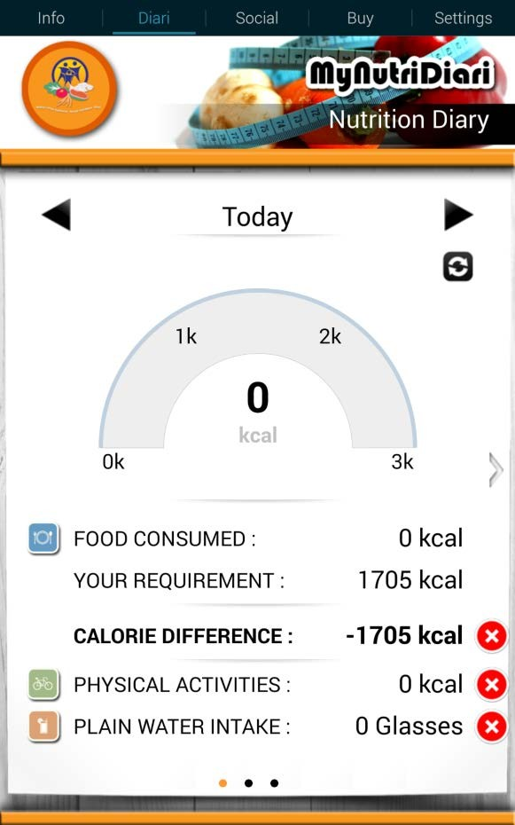

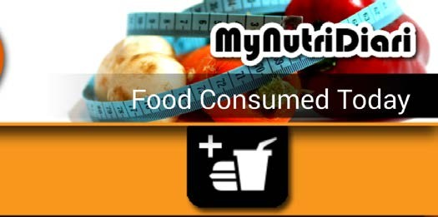

How to Use Food Diary
8
Step 1: Click button “Diari”
Step 3:
Click icon
to look for food or drinks in the database
Step 2:
Click icon which is beside “Food Consumed”

Slide 9
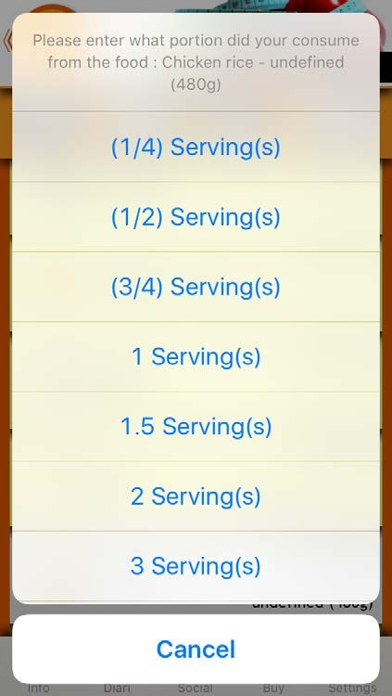
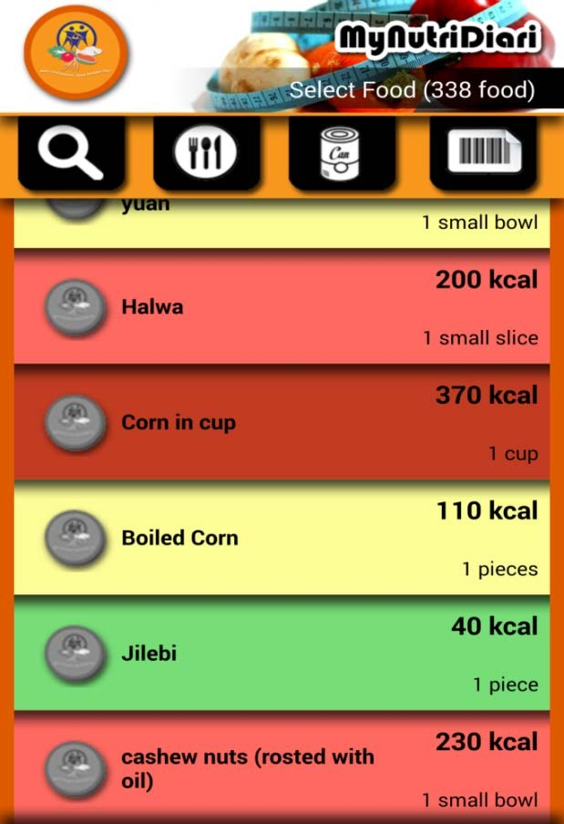
How to Use Food Diary (cont.)
9
Step 4:
Select the consumed food/ drinks from the list
Step 5:
Confirm the portion size of the food consumed and key in into the Food Diary
V

Slide 10

How to Use Food Diary (cont.)
10
Different colour of food/drink represents different calorie content
Colour | Calorie Content | Cooked food/ Fast Food | Kuih tradisional, snack, drinks, fruits and sauce
Green | Low | <100 kcal | 0-50 kcal
Yellow | Moderate | 100-400 kcal | 51-150 kcal
Red | High | 401- 600 kcal | 151-300kcal
Dark Red | Very High | >600 kcal | >300kcal

Slide 11
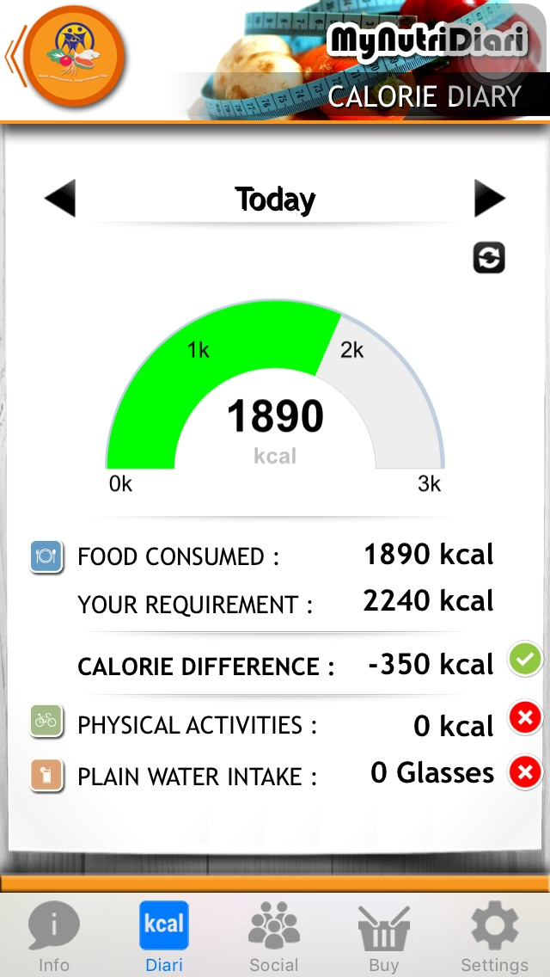
Food Diary
11
The chart helps users to monitor their daily calorie intake.
Calorie difference will be calculated automatically.

Slide 12
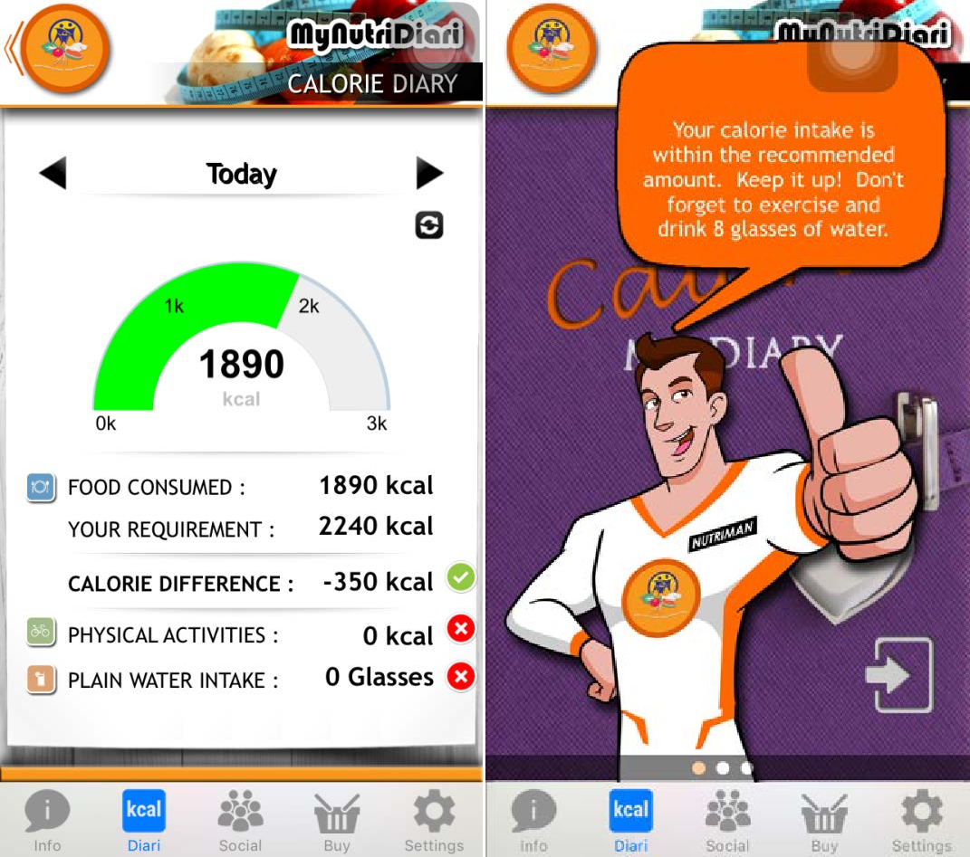
Food Diary
12
The chart will turn green if the calorie intake is within the estimated daily calorie requirements.
A message will pop up to motivate users to eat according to the recommendation and carry out exercise consistently.

Slide 13
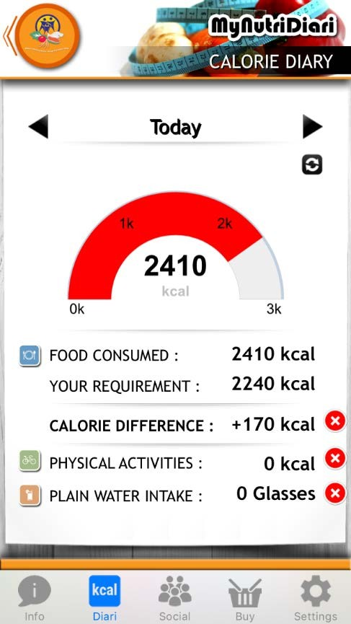
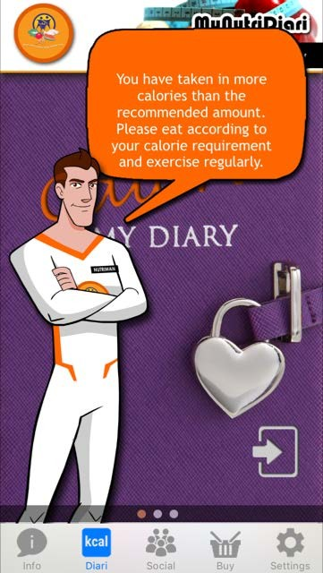
Food Diary
13
The chart will turn red from green if the calorie intake
> estimated daily calorie
requirements.
A message will pop up to alert users to eat according to the recommendation and do some exercise.

Slide 14

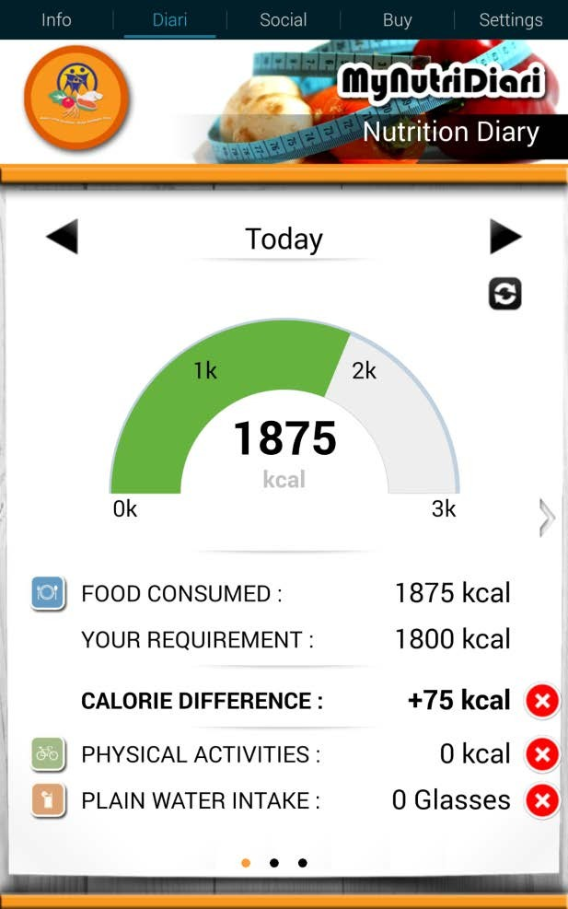
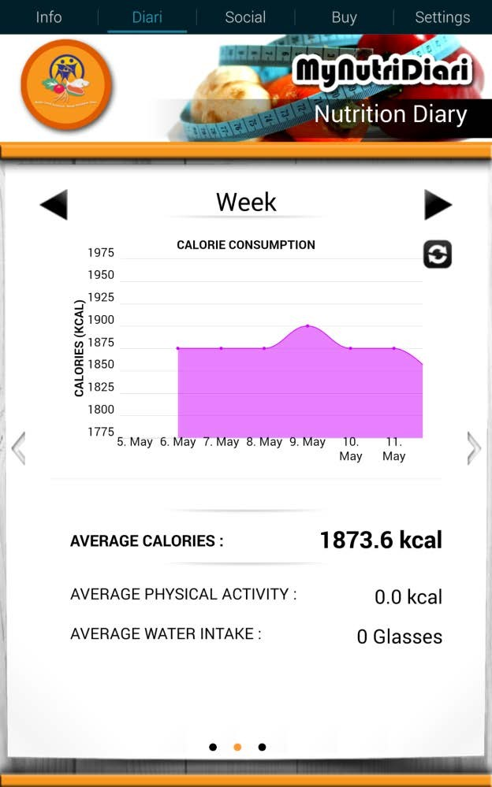
Weekly, Monthly and Annually
Calorie Consumption Monitoring
14
Swipe screen to the right, a graph on calorie consumption pattern will be shown
Users can monitor their calorie consumption weekly, monthly and annually

Slide 15
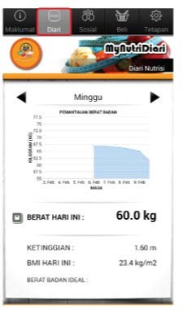
Weekly, Monthly and Annually
Body Weight Monitoring
15
Swipe screen to the right, a graph about pattern of weight change (increase/decrease) will be shown
Users can monitor their body weight weekly, monthly and annually

Slide 16
BARCODE SCANNING
16

Slide 17

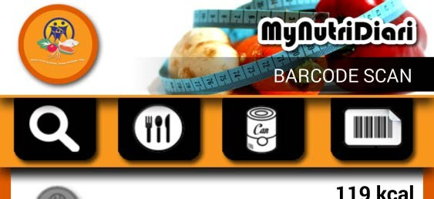

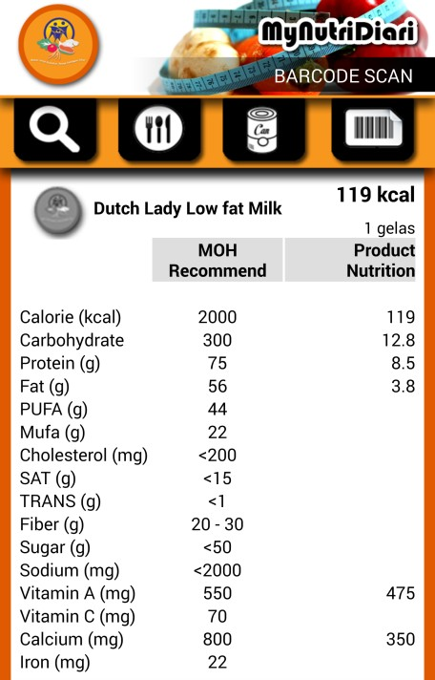

Barcode Scanning
17
Step 3:
Nutrition information of the product will be shown.
[ ]
Step1:
Click icon . to start barcode
scanning
Step 2:
Use smartphone’s camera to capture the product’s barcode

Slide 18
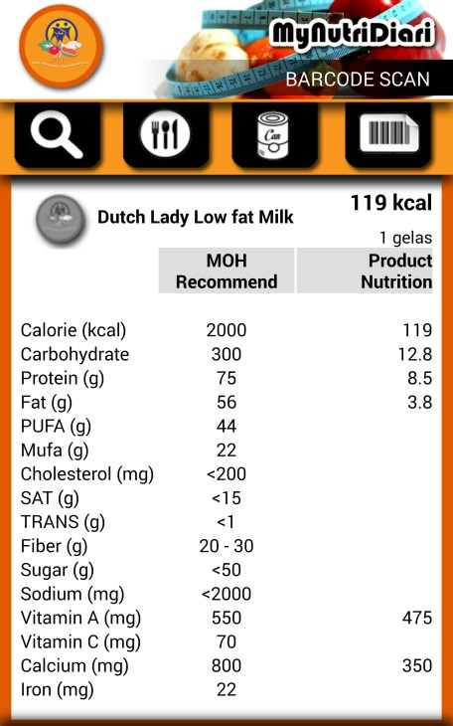
Barcode Scanning (cont.)
18
Nutritional informations of the products will be included in the database automatically.
Helps users to be smarter shoppers – choose products with lower fat/ sugar/salt & higher fibre content.

Slide 19
ENERGY EXPENDITURE
19

Slide 20


Energy Expenditure
20
Click icon be e “Physical Activities” to calculate energy expenditure
sid
Users can monitor their energy expenditure based on the types of physical activities.

Slide 21
SOCIAL
21

Slide 22

“Social” Module
22
Click “Social” button to interact with the administrator
Users can upload photo of food/ drinks, which are not available in the database, to get the nutrition information.
Accurate nutrition information will be provided by the admin within 24 hours, on working day.
How many calories does this food contain?

Slide 23
BUY
23

Slide 24
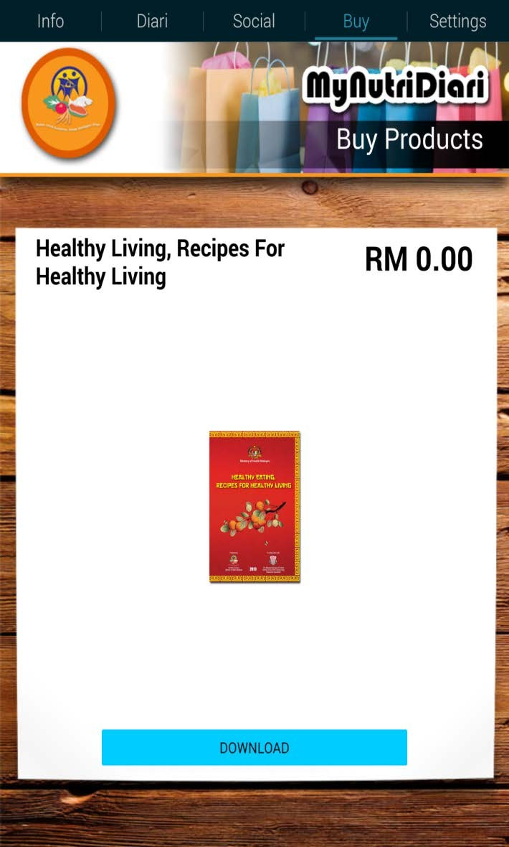
Buy (Mobile Commerce)
24
Click “Buy” button to get FREE published materials and recipe books.

Slide 25
SETTINGS
25

Slide 26
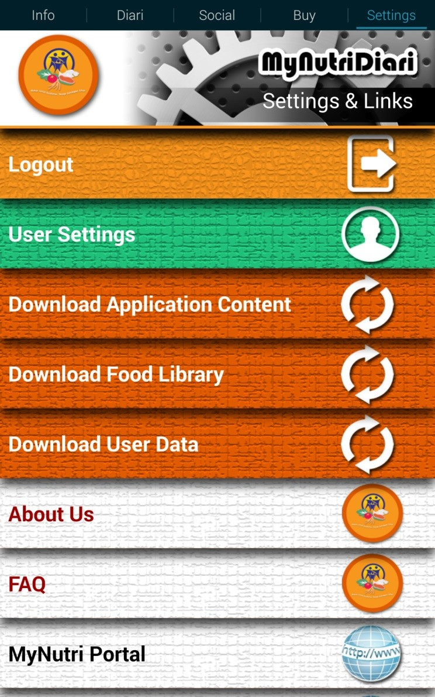
Settings
26
Click “Settings” to get functions below:
Logout button
Update the content of the application, food database and user’s information
Additional Information, such as introduction to Nutrition Division and FAQ
Link to official websites of MOH and Nutrition Division

Slide 27
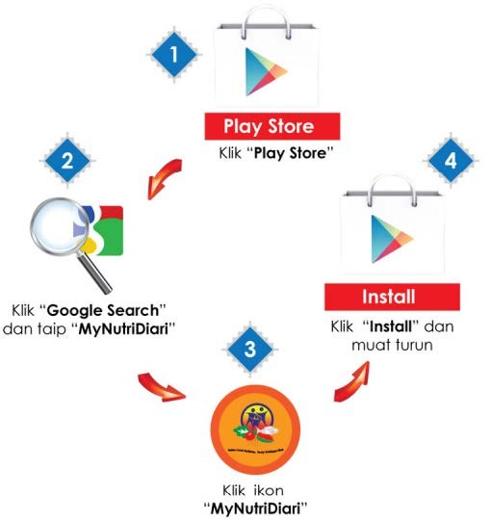





How to Download
MyNutriDiari
27
Click “Play Store” or “App Store”
Click “Play Store”
Click “Google Search” and type “MyNutriDiari”
Click “Install” to download
Click icon “MyNutriDiari
DOWNLOAD FOR FREE!

Slide 28
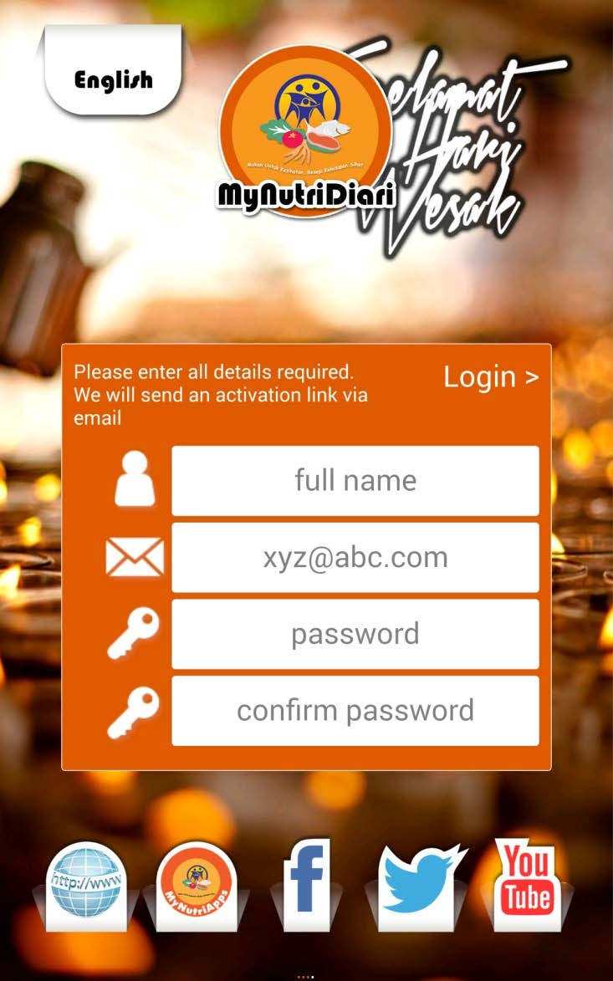
New Account Registration
28
User can choose
B. Melayu or English.
Enter:
Full name
Email address
Password

Slide 29
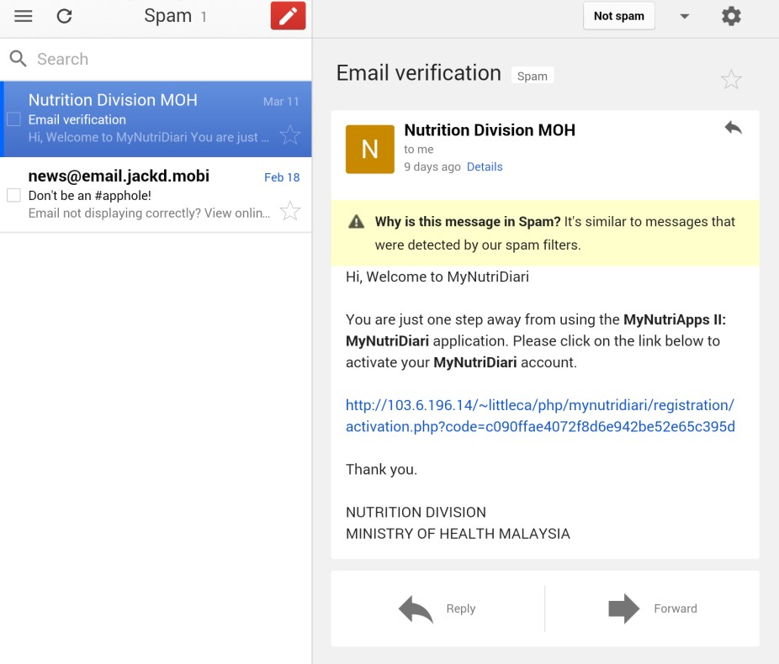
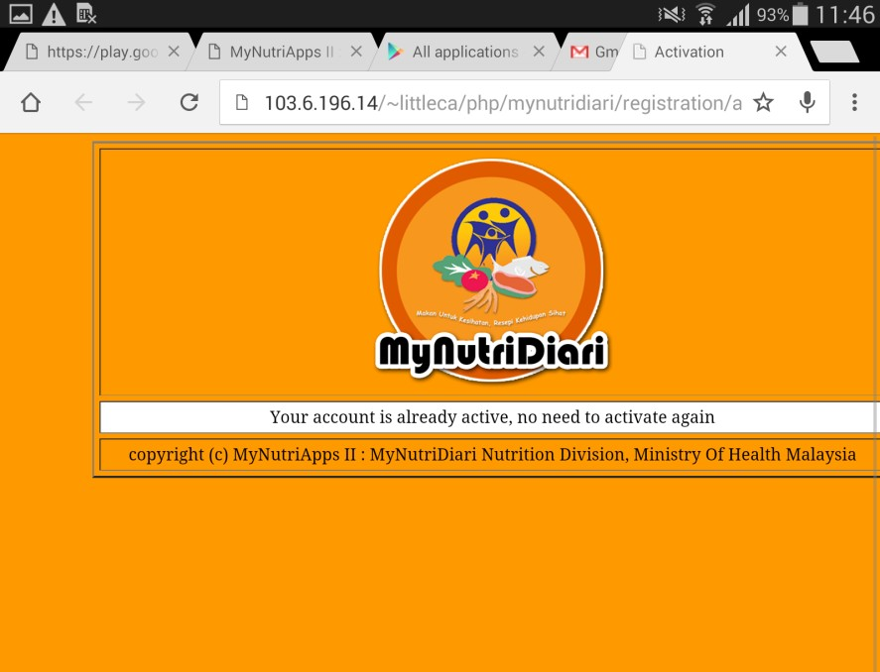
Activation Email from MyNutriDiari
29
Please check your email (inbox / spam mail/ junk mail) and activate your account by clicking the activation link .

Slide 30
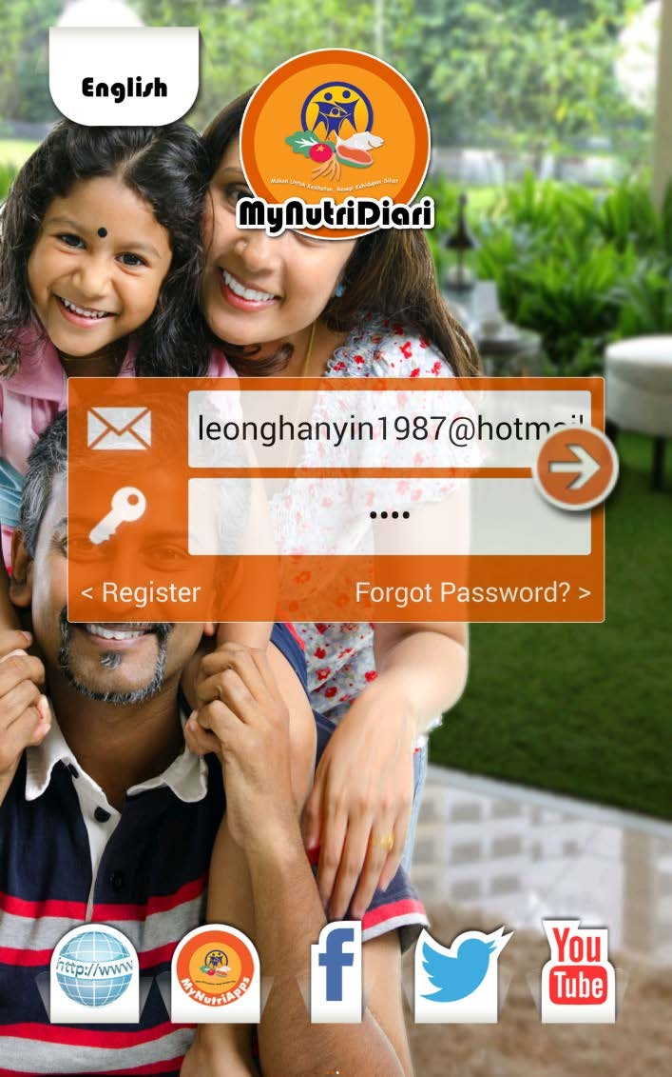
Log in
30
Log in your account to start using MyNutriDiari.

Slide 31
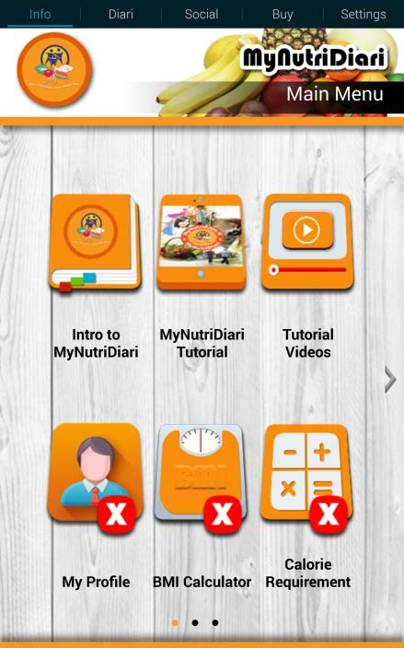
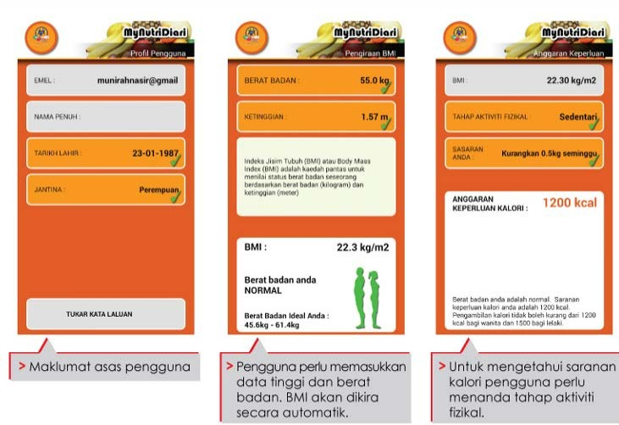
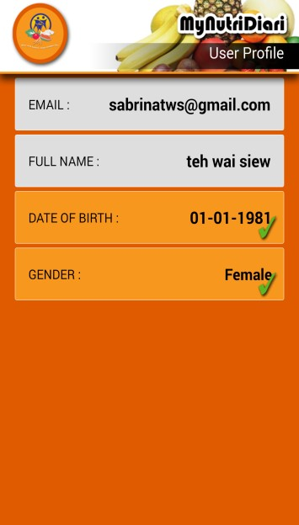
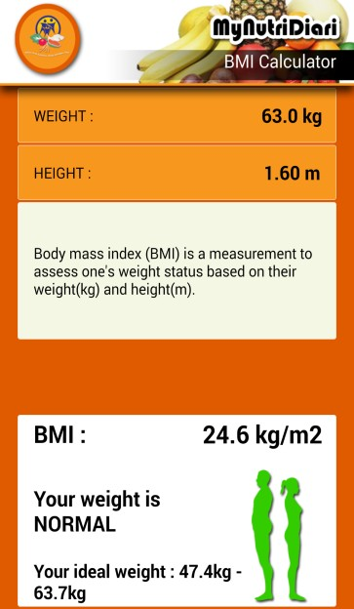
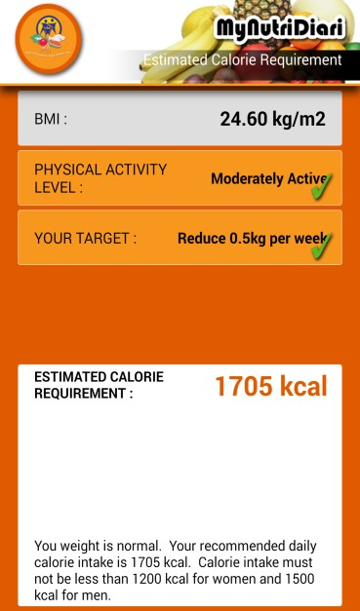

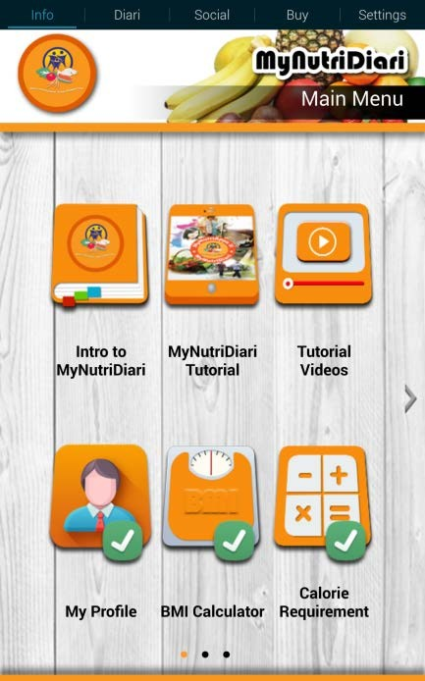






Basic Information
31
Your Estimated Daily Calorie Requirement
Your BMI Status
User’s basic information
User needs to enter height | User needs to enter
and weight. BMI will be | physical activity level to
automatically calculated | estimate calorie
 | requirement
Enter basic information in :
My Profile (Date of Birth & Gender)
BMI Calculation (Height & Weight)
Calorie Requirement (Physical Activity Level & Targets)

Slide 32
Promotion & Advocacy
32
Radio/ TV Program
IPTA/ IPTS
Public
iM4U
Meetings
MyNutri Diari
Gov Agencies
Nutrition Counselling
Patients
Cooking Demonstration
Health Talk
KOSPEN
Private Agencies
Exhibition/ Roadshow
Training/ Short Courses

Slide 33
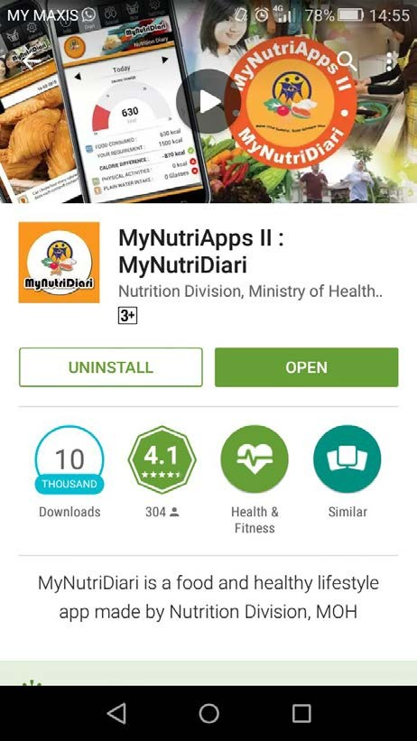


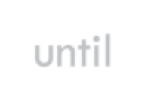



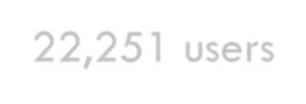



Achievements
33
Cumulative total downloaders until 2 August 2016:
22,251 users
User Acceptance Level: 4.1 / 5.0

Slide 34















Achievements
34
With the characteristic of Health Services Delivery in Expanding Health Promotion and Disease Prevention Effort, MyNutriDiari has been selected as part of Health Services Transformation Plan (PTPK) 2016 in MOH.

Slide 35
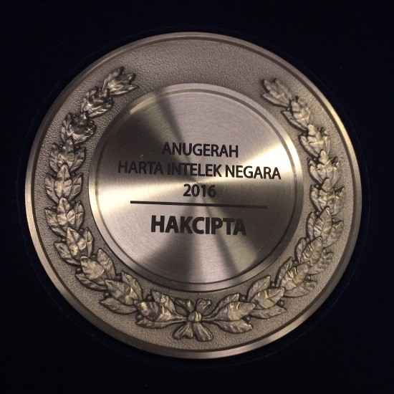






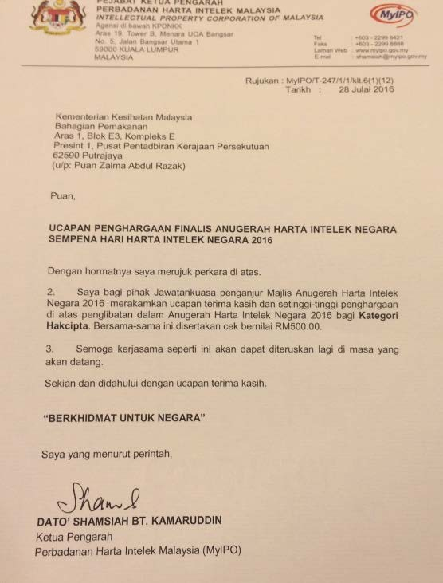









Acheivements
35
MyNutriDiari initiative has participated in numerous awards and innovation contests.
Recently, MyNutriDiari won a consolation prize in Anugerah Harta Intelek Negara (AHIN) 2016 for the “Copy Right” Category.

Slide 36
Challenges
36
1. | Users’ Acceptance on MyNutriDiari | Users might feel reluctant and uncomfortable when asking to record their daily food consumption into food diary consistently at the initial stage.
2. | Sustainability of users’ interest | Users might lose interest and feel tedious to record their daily food consumption after exploring MyNutriDiari for a period of time.
3. | Cost | Significant budget is needed for further development and maintenance of MyNutriDiari application.

Slide 37
Challenges
37
4. | Food Database | MyNutriDiari food database needs to be strengthened and expanded from time to time to ensure the accuracy and diversity of the data.
5. | Technical glitches/ bugs | Example: Incompatibility between some smartphones with MyNutriDiari application

Slide 38

38
MYNUTRIAPPS II: MYNUTRIDIARI
MyNutriDiari, Calories at Your Fingertips!

Slide 39

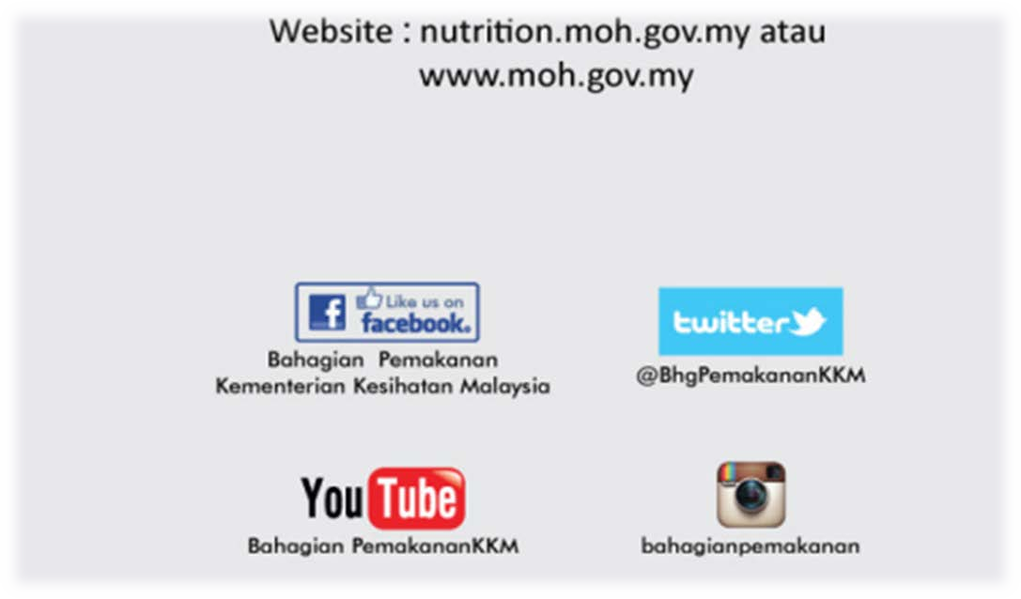
Thank You
39

